Slide 1
Rocks

Slide 2
Rocks
There are 3 types of rocks.
Igneous, metamorphic and sedimentary.
Some rocks have air bubbles because of the way they are formed.
Rocks such as Millstone Grit have these properties and are otherwise known as Sedimentary Rocks
Other rocks don’t have air bubbles, these tend to have crystals
Crystals have a more jagged form (meaning they fit together more easily)
This means there’s less air bubbles therefore its a denser rock
Metamorphic and Igneous rocks have these properties.

Slide 3

Metamorphic
Metamorphism means "changed form".
The Changes occur because of:
Heat
Pressure

Slide 4
How metamorphic rocks change
Say a sedimentary rock is pushed down towards the earth’s mantle
The magma heats it up and changes its structure
Also the pressure can take part in this process.
The pressure comes from rocks above and they get pushed down.
So the texture, mineral structure and physical properties all change
However, they have the same because they have the same chemical compounds.

Slide 5
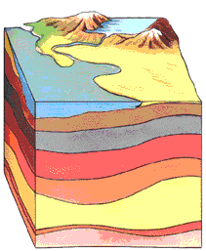
Sedimentary Rocks
For thousands, even millions of years, little pieces of our earth have been eroded
broken down and worn away
by wind and water
These little bits of our earth are washed downstream where they settle to the bottom of the rivers, lakes, and oceans
Layer after layer of eroded earth is deposited on top of each

Slide 6
Continued ...
These layers are pressed down more and more through time, until the bottom layers slowly turn into rock.
The weight of all the layers squeezes out most of the water from the sediment
Chemicals in the water cement the bits of sand and mud together
A new sedimentary rock has formed !

Slide 7
Igneous Rocks
Igneous rocks are formed ...
When molten rock (magma) is pushed up from beneath the earth’s crust
It cools to form solid rock
Properties
They contain crystals and they are hard
There are two types of igneous rock
Intrusive and extrusive

Slide 8
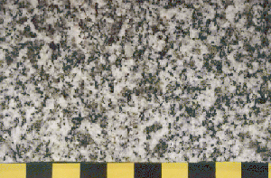
Continued...
Intrusive igneous rocks have cooled slowly in the earth’s crust
They have large crystals
Extrusive igneous rocks cool quickly
They have small crystals

Slide 9
Presented by:
Antoinette and
Kailyn

Slide 10
This powerpoint was kindly donated to www.worldofteaching.com
http://www.worldofteaching.com is home to over a thousand powerpoints submitted by teachers. This is a completely free site and requires no registration. Please visit and I hope it will help in your teaching.

